Slide 1
Minimum Edit Distance
Definition of Minimum Edit Distance

Slide 2
How similar are two strings?
Spell correction
The user typed “graffe”
Which is closest?
graf
graft
grail
giraffe
Computational Biology
Align two sequences of nucleotides
Resulting alignment:
AGGCTATCACCTGACCTCCAGGCCGATGCCC
TAGCTATCACGACCGCGGTCGATTTGCCCGAC
-AGGCTATCACCTGACCTCCAGGCCGA--TGCCC---
TAG-CTATCAC--GACCGC--GGTCGATTTGCCCGAC
Also for Machine Translation, Information Extraction, Speech Recognition

Slide 3
Edit Distance
Natural language processing is concerned with measuring how similar two strings are.
The minimum edit distance between two strings
Is the minimum number of editing operations
Insertion
Deletion
Substitution
Needed to transform one into the other
Minimum edit distance between two strings is defined as the minimum number of editing operations (operations like insertion, deletion, substitution) needed to transform one string into another.

Slide 4
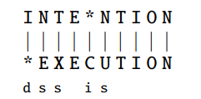
Minimum Edit Distance
Two strings and their alignment: Given two sequences, an alignment is a correspondence between substrings of the two sequences.
The Levenshtein distance between two sequences is the simplest weighting factor in which each of the three operations has a cost
If each operation has cost of 1
Distance between these is 5
If substitutions cost 2 (Levenshtein)
Distance between them is 8

Slide 5
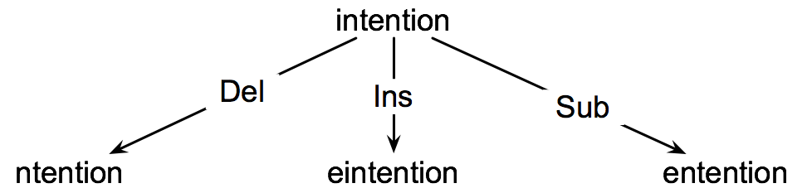
How to find the Min Edit Distance?
Searching for a path (sequence of edits) from the start string to the final string:
Initial state: the word we’re transforming
Operators: insert, delete, substitute
Goal state: the word we’re trying to get to
Path cost: what we want to minimize: the number of edits

Slide 6
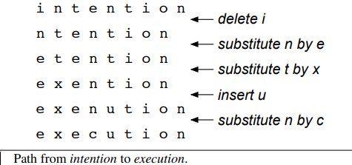
shortest path of transformed words that represents the minimum edit distance between the strings intention and execution

Slide 7
Defining the minimum edit distance
Given two strings,
the source string X of length n,
and target string Y of length m,
we’ll define D[i, j] as the edit distance between X[1..i] and Y[1.. j],
i.e., the first i characters of X and
the first j characters of Y.
The edit distance between X and Y is thus D[n,m].
We’ll use dynamic programming to compute D[n,m] bottom up, combining solutions to sub problems.

Slide 8
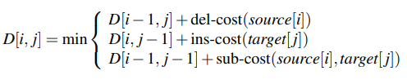
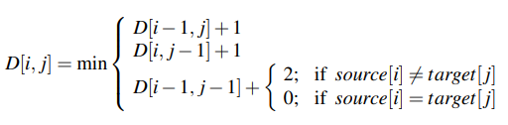
The value of D[i, j] is computed by taking the minimum of the three possible paths through the matrix which arrive there:
If we assume the version of Levenshtein distance in which the insertions and deletions each have a cost of 1 (ins-cost(·) = del-cost(·) = 1), and substitutions have a cost of 2 (except substitution of identical letters have zero cost), the computation for D[i,j] becomes:

Slide 9
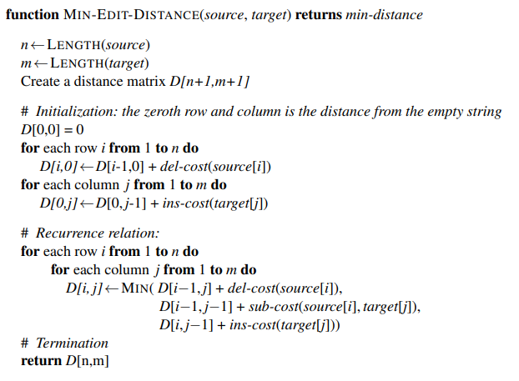
Min Edit Distance Algorithm

Slide 10
Dynamic Programming for Minimum Edit Distance
Dynamic programming: A tabular computation of D(n,m)
Solving problems by combining solutions to subproblems.
Bottom-up
We compute D(i,j) for small i,j
And compute larger D(i,j) based on previously computed smaller values
i.e., compute D(i,j) for all i (0 < i < n) and j (0 < j < m)

Slide 11
The Edit Distance Table
N | 9
O | 8
I | 7
T | 6
N | 5
E | 4
T | 3
N | 2
I | 1
# | 0 | 1 | 2 | 3 | 4 | 5 | 6 | 7 | 8 | 9
 | # | E | X | E | C | U | T | I | O | N

Slide 12
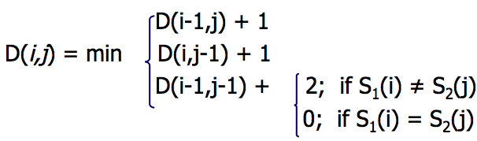
The Edit Distance Table
N | 9
O | 8
I | 7
T | 6
N | 5
E | 4
T | 3
N | 2
I | 1
# | 0 | 1 | 2 | 3 | 4 | 5 | 6 | 7 | 8 | 9
 | # | E | X | E | C | U | T | I | O | N

Slide 13
Edit Distance
N | 9
O | 8
I | 7
T | 6
N | 5
E | 4
T | 3
N | 2
I | 1
# | 0 | 1 | 2 | 3 | 4 | 5 | 6 | 7 | 8 | 9
 | # | E | X | E | C | U | T | I | O | N

Slide 14
The Edit Distance Table
N | 9 | 8 | 9 | 10 | 11 | 12 | 11 | 10 | 9 | 8
O | 8 | 7 | 8 | 9 | 10 | 11 | 10 | 9 | 8 | 9
I | 7 | 6 | 7 | 8 | 9 | 10 | 9 | 8 | 9 | 10
T | 6 | 5 | 6 | 7 | 8 | 9 | 8 | 9 | 10 | 11
N | 5 | 4 | 5 | 6 | 7 | 8 | 9 | 10 | 11 | 10
E | 4 | 3 | 4 | 5 | 6 | 7 | 8 | 9 | 10 | 9
T | 3 | 4 | 5 | 6 | 7 | 8 | 7 | 8 | 9 | 8
N | 2 | 3 | 4 | 5 | 6 | 7 | 8 | 7 | 8 | 7
I | 1 | 2 | 3 | 4 | 5 | 6 | 7 | 6 | 7 | 8
# | 0 | 1 | 2 | 3 | 4 | 5 | 6 | 7 | 8 | 9
 | # | E | X | E | C | U | T | I | O | N

Slide 15
Minimum Edit Distance
Back trace for Computing Alignments

Slide 16
Computing alignments
Edit distance isn’t sufficient
We often need to align each character of the two strings to each other
We do this by keeping a “backtrace”
Every time we enter a cell, remember where we came from
When we reach the end,
Trace back the path from the upper right corner to read off the alignment

Slide 17
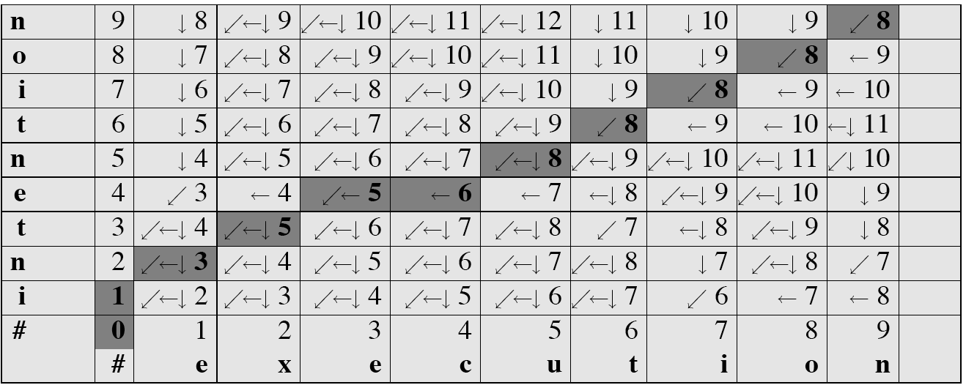
MinEdit with Backtrace
starting at the 8 in the lower-right corner and following the arrows back.
The sequence of bold cells represents one possible minimum cost alignment between the two strings.

Slide 18
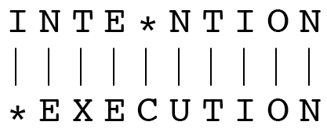
Result of Backtrace
Two strings and their alignment:

Slide 19
Performance
Time:
O(nm)
Space:
O(nm)
Backtrace
O(n+m)

